Slide 1
Fire Plumes FireWork/GEMMACH vs. MISR
Prepared by: Elisa Dong
Mar 21, 2016

Slide 2
Goals
Analyze FireWorks plume rise (height) results against MISR (MINX) results
Find potential issues/bias using MINX software
Establish benchmark for upcoming comparison with CFFEPS

Slide 3
Coverage
Apr – Oct 2017 (ie. 2017 fire season)
All of Canada
Sample Command using preMINX
preMINX -L -142.0 -50.7 42.0 83.0 -d 2017.07.01 2017.07.31 -u elisadong --grandir ./granules
Notes:
Coverage includes fire season of 2017 for all of Canada. Included is a sample command that retrieves the corresponding data for the coverage area for the month of July.

Slide 4
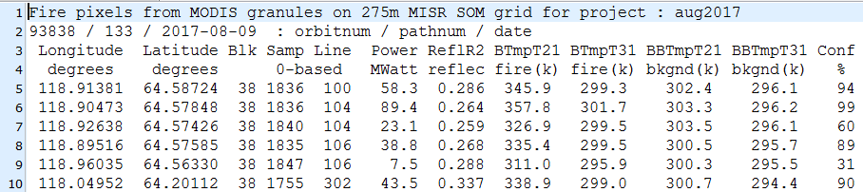
Process
Download appropriate MISR/MODIS data, FirePixels (preMINX)
Filter FirePixels by percentile (FRP), then confidence level (P50, C60) to reduce digitizing efforts
Digitize plumes (MINX4), user selects appropriate bands
Keep only Fair/Good plumes
Pass through several functions for analysis and comparison (postMINX, speedAltMINXdemo, binPercentiles, etc)
Naming sense is not great
Notes:
Reminder: pre/postMINX are programs written by Nolan (demonstrated previously) to help with downloading and processing of data before and after digitization (MINX)
Download data for coverage area/time
Reduce the number of fires to look at by only looking at 50th percentile of fires (by Fire Radiative Power, how big is our fire), then by how confident MODIS is about the fire identification. Example of fire pixel file below
Digitize the plumes (involves drawing circle around a fire plume, giving a wind direction)
MINX has it’s own way of telling the user if it’s a good digitization, keep only Fair/Good results
After digitizing, can compare to model. Do this using various programs

Slide 5
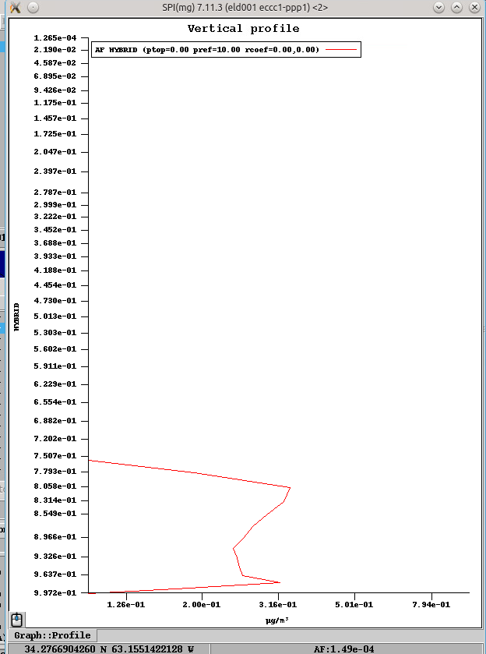
Model Plumes
Determination of Model Plume location/height is dependent on
Digitized plume location
Model: FireWork FST – GEMMACH FST
StartTime: 00, over forecast 24 hours
Threshold: AF > 0
Local Max of AF values from model
Local max
Notes:
Possibly include an illustration (vertical profile of AF)
Getting corresponding model plume.
Given location of points in the digitized plumes, can find matching points in FSTs
In this case, use two FSTs. The operational FireWork results less the GEMMACH results
Find the appropriate FSTs by matching plume time to FST timestamp. In this case, looking at model results starting from midnight and the first 24 forecasted hours
Select a threshold for what indicates a plume (PM2.5 > 0), see illustration
Find the highest local max for PM2.5
Note: FireWork – GEMMACH allows for threshold 0 because anthropomorphic affects. If only looking at the FireWork results, would require setting threshold to something higher (ex. 15). StartTimes indicate what time during the day the model starts running.
Graph from:
App/Script : SPI
Version : 7.11.3
SPI library : 7.11.3
Hostname : eccc1-ppp1
Architecture : ubuntu-14.04-amd64-64
Run ID : SPI-20180321_184043
Start time : Wed Mar 21 18:40:43 GMT 2018

Slide 6
Results (Apr-Oct 2017, P98)
Plumes Processed | 203
Number of Valid Pairs | 9971
Number of Dropped Pairs | 10273
Minimum FRP (MWatts) | 243.95
MINX Plume Max | 8759
Model Plume Max | 5541.54541
MINX Plume Min | 322
Model Plume Min | 124.6417236
MINX Plume Mean | 2806.447397
Model Plume Mean | 1562.115637
RMSD | 1684.2709
Pearson Correlation Coefficient, pValue | 0.485868138710415, 0
R Squared, pValue | 0.236067848213927, 0, 'y = 0.398811854941x + 442.87114428'
Mean Absolute Percent Error | 50.1600712
Mean Percentage Error | 40.52520558
Notes:
Note on percentiles: Ran several (50, 90,95,98,99.9)
Used 98 in this example, fairly representative and has a good number of plumes. Can look at the 50th percentile results, not much difference in results (more cluttered in displays though, 420 plumes, 14442 pairs) though cut out some other weird outliers.
When going to 99.9 percentile, cleans out a lot of potentially import trends. Otherwise, increasing percentile does not noticeably improve the overall result.
NOTE: Seemingly low number of plumes, MINX also pre-filters based on total FRP in a band (section to digitize). If there is only one small fire, won’t show up.
Stats definitions:
RMSD – Root Mean Square Deviation, sample standard deviation between predicted values and observed values. (how far is the model height from the MINX height)
Pearson Correlation Coefficient - measure of the linear correlation between two variables. (how predictable is the model value from the minx value)
R Squared (coefficient of determination) – measure of how much variance in the dependent variable is predicted by the independent variable (in this case, how well the regression line explains the scatter plot)
MAPE – shows accuracy of trend prediction (how good will our regression line be?)
MPE - average of percentage errors by which forecasts of a model differ from actual values of the quantity being forecast (how off are the model values?)
pValue - calculated probability, is the probability of finding the observed, or more extreme, results when the null hypothesis (H₀) of a study question is true

Slide 7
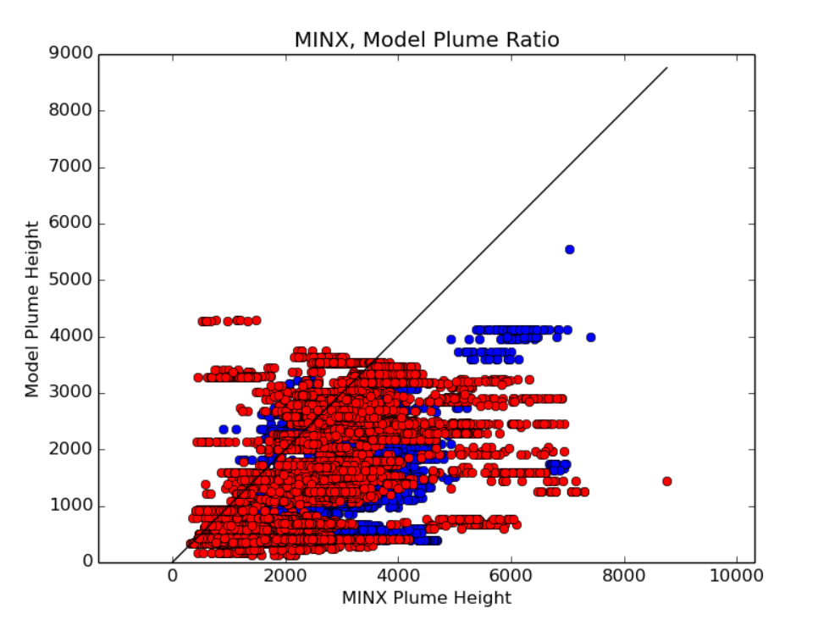
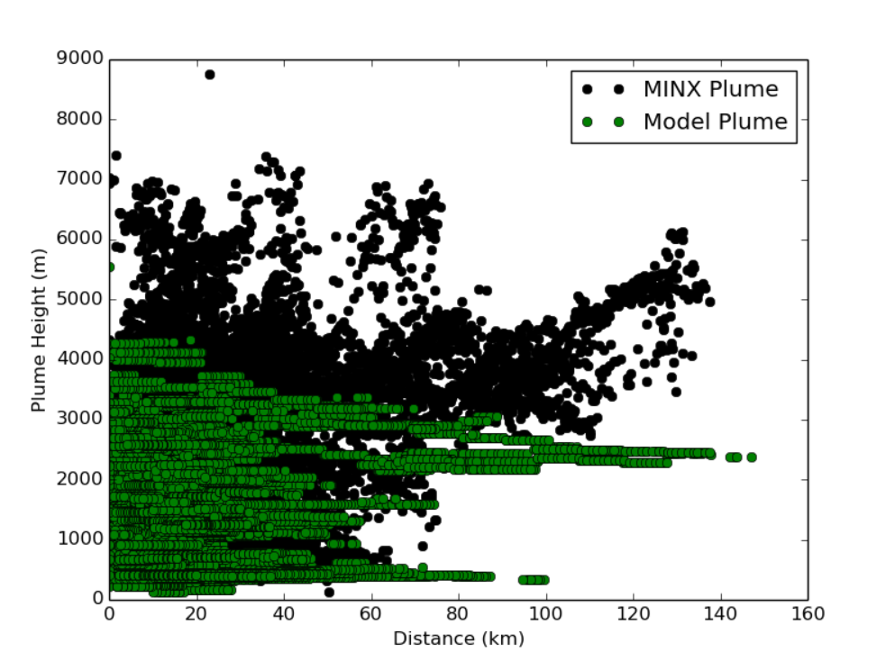
Plume Heights
Model by MINX plume height
Plume Height by Distance
Notes:
Two different ways at looking at results from digitized plumes and model plumes.
Model plume height is y axis, black line is 1:1
Black dots are digitized heights, green are model heights, plotted along distance from origin of plume
Note underestimation for the most part. Most variation in the model plume is near the origin of the plume

Slide 8
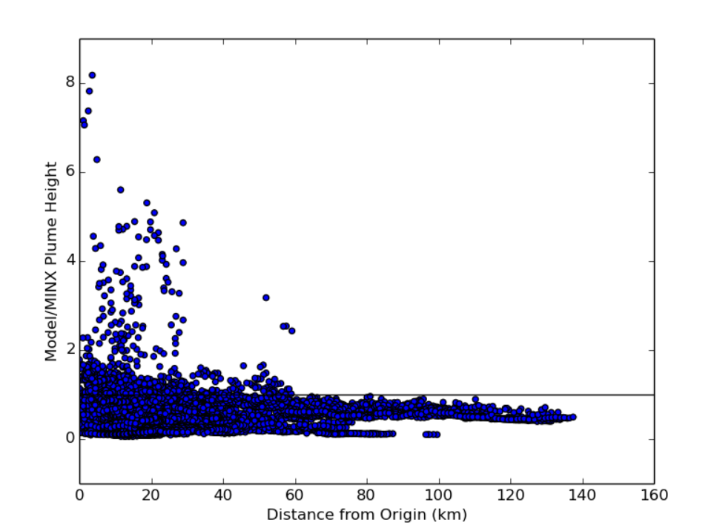
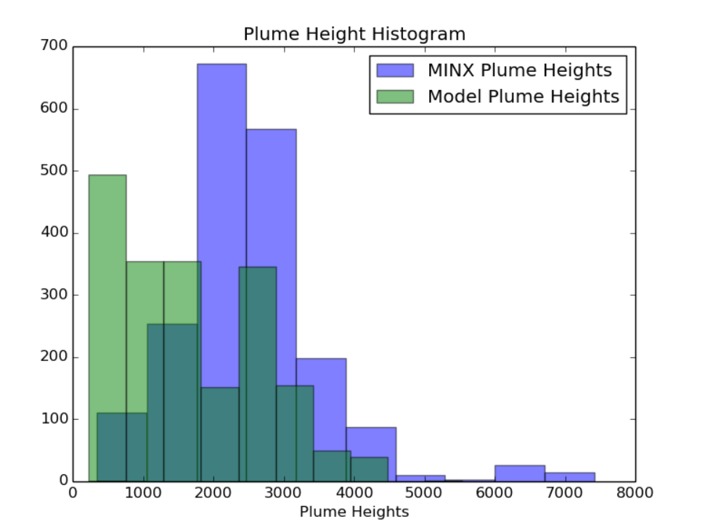
Plume Heights by Distance
Model/MINX Ratio
Plume Heights (0-10km)
Notes:
See majority is underestimation, but closer to the origin there is some overestimation by the model results.
Histogram displayed is only from 0-10km range. Note that we’re still seeing a general underestimation close to the origin of fire.
To see histogram for entire range: https://hpfx.science.gc.ca/~eld001/MINXResults/FW-GM_start00/plumeAnalysisApr_Oct/DistanceHist_thresh0_prct98.png

Slide 9
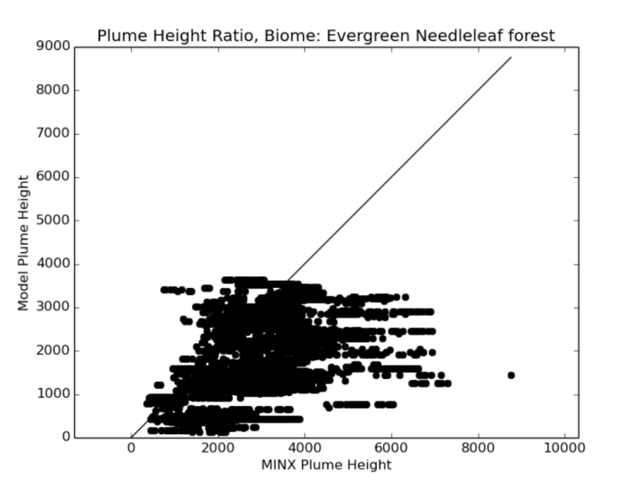
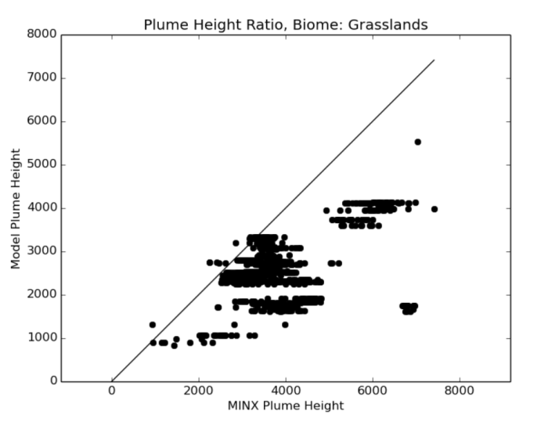
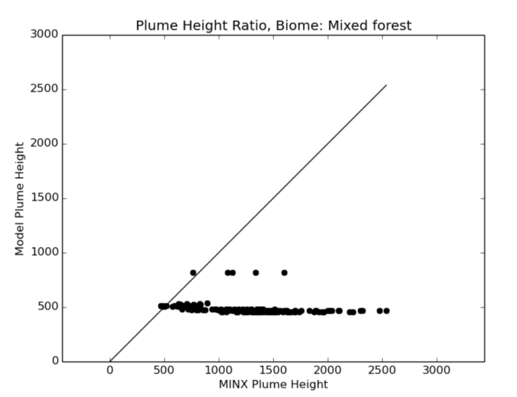
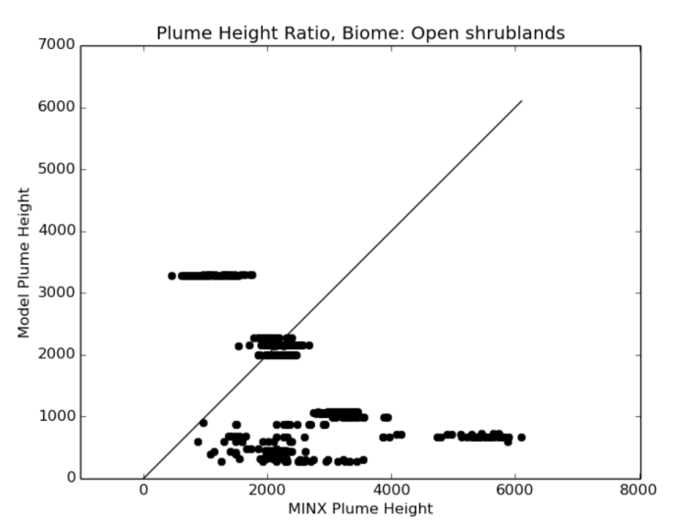
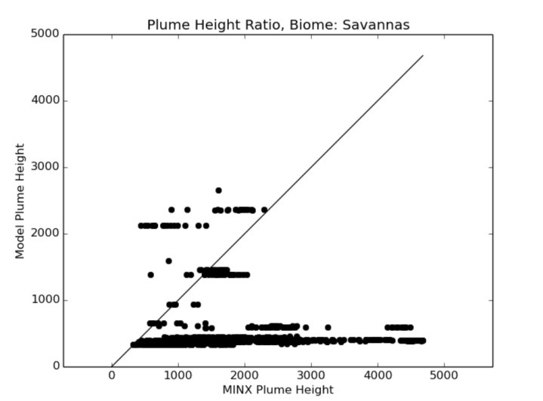
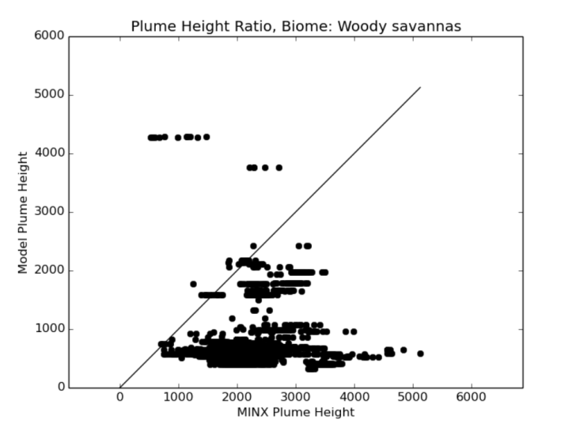
Breakdown by Biome
Notes:
Breakdown of all plume heights by biome.
Biome determination is by MINX (in the resulting raw plume data)
Note that most of them show underestimation. There are some overestimations in the evergreen needleleaf forest, open shrublands, savannas and woody savannas.
Currently, no good conclusions on this.
Working on breakdown by fuels

Slide 10
MINX Caveats
Using filtered height, other ‘heights’ available
User selection of red/blue band (affects resolution)
Terrain offset (1 pixel = hundreds of meters)
Topography effects (depressions, valleys)
Thin aerosols
Bright clouds (high albedos)
Fire Pixel masking, bowtie effect
Satellite pass time (10:30am)
Notes:
Filtered height: The height above sea level of the feature measured at this point corrected for wind and smoothed with a filter that considers only local variations
Red/Blue band: user can select which to digitize in. Usually use red unless can see terrain below.
Terrain offset: terrain data may be off when digitizing, a potential issue that can result in incorrect digitizations
Topography: Changes in topography can affect plume shape and movement, hard to tell impacts right now
Thin aerosols: Sometimes plumes cannot be distinguished from land
High Albedos: Sometimes plumes cannot be distinguished from clouds
Fire Pixels: Some fires can be covered by clouds, some can be duplicated
Satellite Pass Time: Potentially seeing only immature fires, not very representative

Slide 11
Model Caveats
Low Resolution Grid
Using Nearest Neighbour
Other methods of determining plume height exist
Notes:
In this example, grid is 10 km resolution.
Nearest neighbour thus may give us all the same heights for a small plume.
Some other methods of determining model height do exist

Slide 12
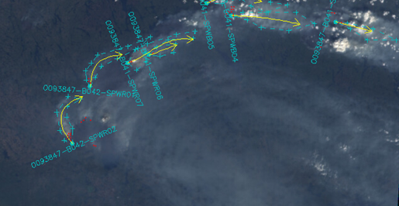
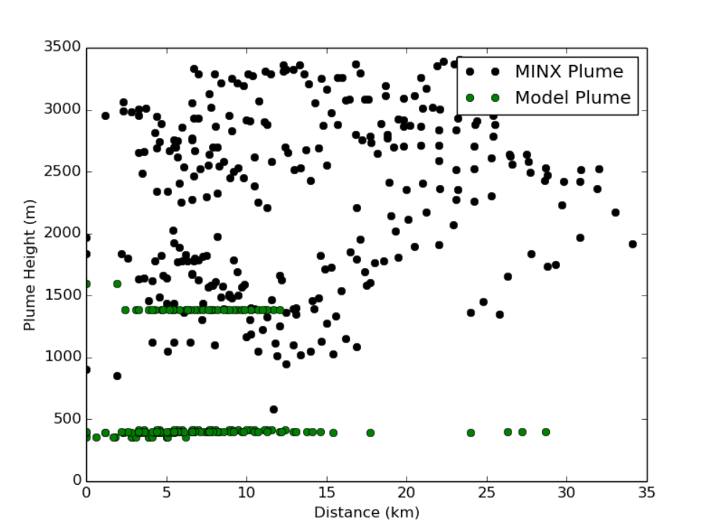
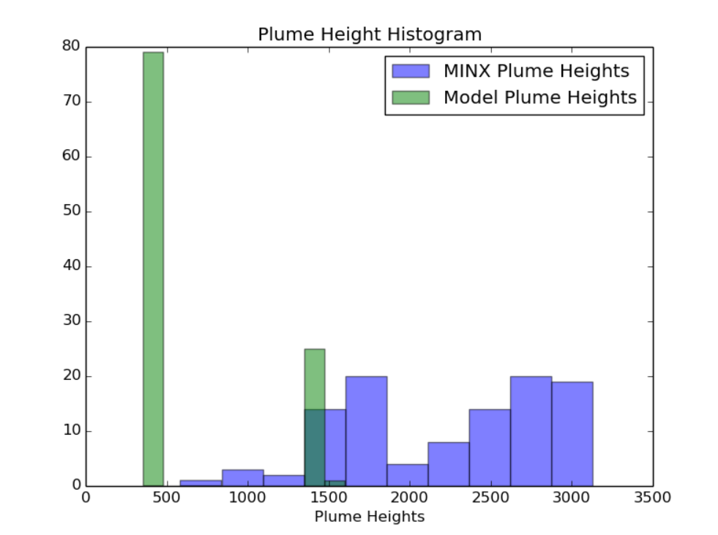
Case Study
Notes:
Less case study, more pointing out some issues with smaller plumes (the majority of plumes digitized)
We see the issues with using low resolution grid to represent our model plumes.
Details of plume heights are missed out (less variance)
Clear underestimation
https://hpfx.science.gc.ca/~eld001/MINXResults/FW-GM_start00/plumeAnalysisAug9CaseStudy/

Slide 13
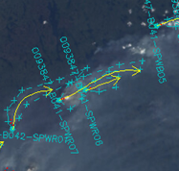
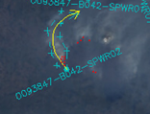
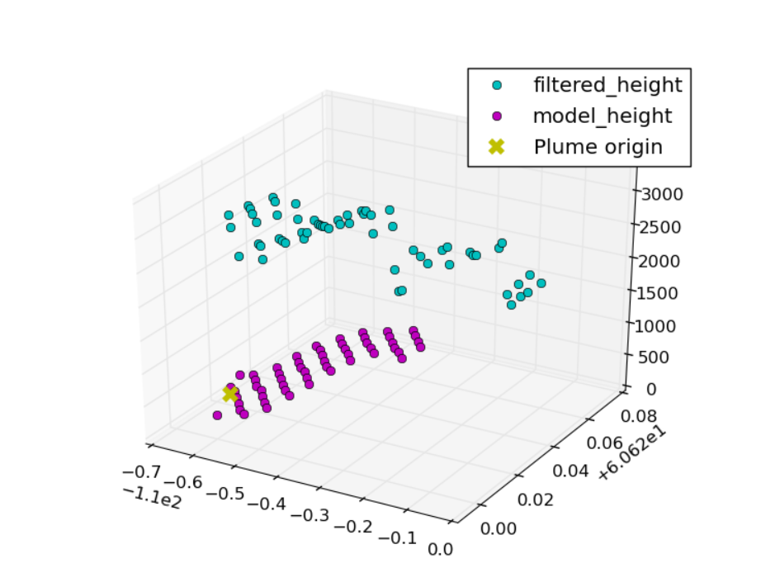
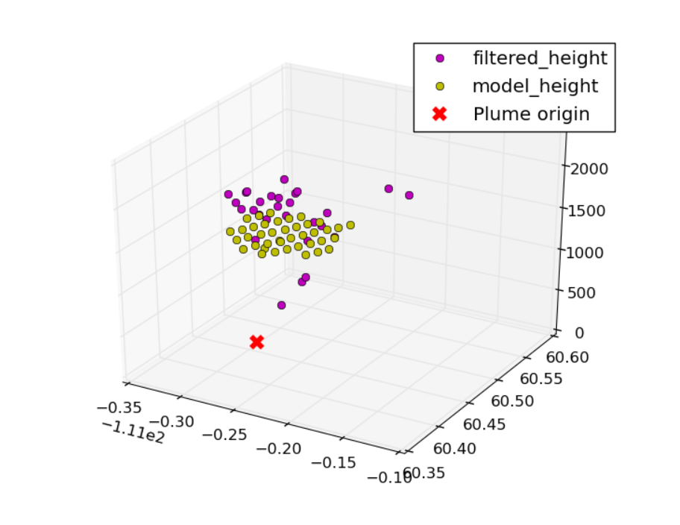
Case Study – 2 Plumes
O093847-B041-SPWR07
O093847-B042-SPWR02
Notes:
3D plot of two of the plumes captured in the previous slide. Note that model has fewer points than the digitized result, and is very flat in comparison.

Slide 14
In Progress/Future Goals
Different model (CFFEPS)
Comparison of CFFEPS to FireWork (monthly comparisons may also be useful)
Consider different model plume height retrieval methods (10% of max PM2.5, CO levels, etc)
Incorporate CALIOP data to validate MINX results (really long-term goal)
Notes:
Time dependent goals

Slide 15
Link to results
https://hpfx.science.gc.ca/~eld001/MINXResults/FW-GM_start00/

